Slide 1
Research ai agent
IBM HACKATHON PROJECT
Presented By:
Student name : Anwesh Kale
College Name & Department : MIT Academy of Engineering
& Computer Engineering

Slide 2
OUTLINE
Problem Statement
Technology used
Wow factor
End users
Result
Conclusion
Git-hub Link
Future scope
IBM Certifications

Slide 3
Problem Statement
Researchers, students, and professionals often struggle to stay updated with the rapidly growing volume of academic publications, technical articles, datasets, and evolving research trends. Manually reviewing, filtering, and synthesizing information across multiple domains is time-consuming and inefficient.
Proposed Solution: An AI Research Agent that uses Natural Language Processing (NLP), Retrieval-Augmented Generation (RAG), to assist users in conducting efficient literature reviews, generating summaries, identifying research gaps, and recommending relevant papers, datasets, or collaborators.

Slide 4
Technology used
IBM cloud lite services
Natural Language Processing (NLP)
Retrieval Augmented Generation (RAG)
IBM Granite model

Slide 5
IBM cloud services used
IBM Cloud Watsonx AI Studio
IBM Cloud Watsonx AI runtime
IBM Cloud Agent Lab
IBM Granite foundation model

Slide 6
Wow factors
This intelligent assistant is designed to streamline the research process, enhance the depth and clarity of literature reviews, guide early-career scholars in shaping their research paths, and encourage cross-disciplinary engagement by making complex information easier to discover and apply.
Key capabilities include:
Semantic-level exploration across academic papers, journals, and data repositories
Automated summaries of chosen publications
Reference and citation tracking to understand scholarly impact
Smart recommendations aligned with the user’s research focus
Keyword and domain trend visualization over time
Collaboration insights: identifies researchers or institutions with aligned interests for potential partnerships

Slide 7
End users
Academic Researchers
Research Institutions and Universities
Industry R&D Teams
Educators

Slide 8
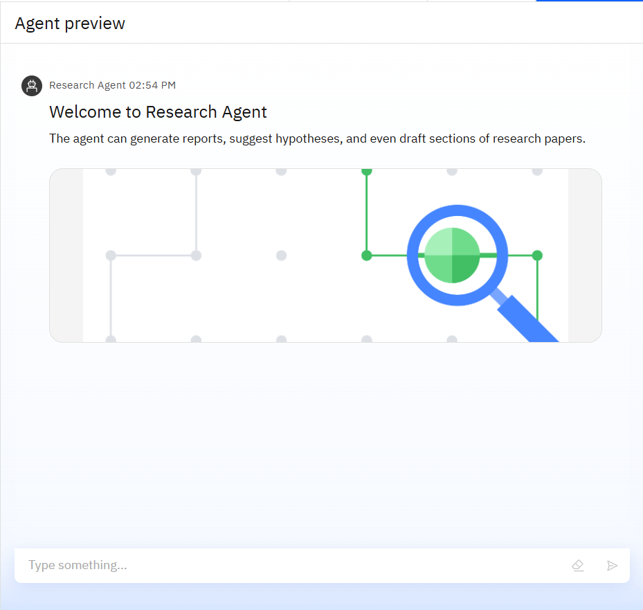
Results

Slide 9
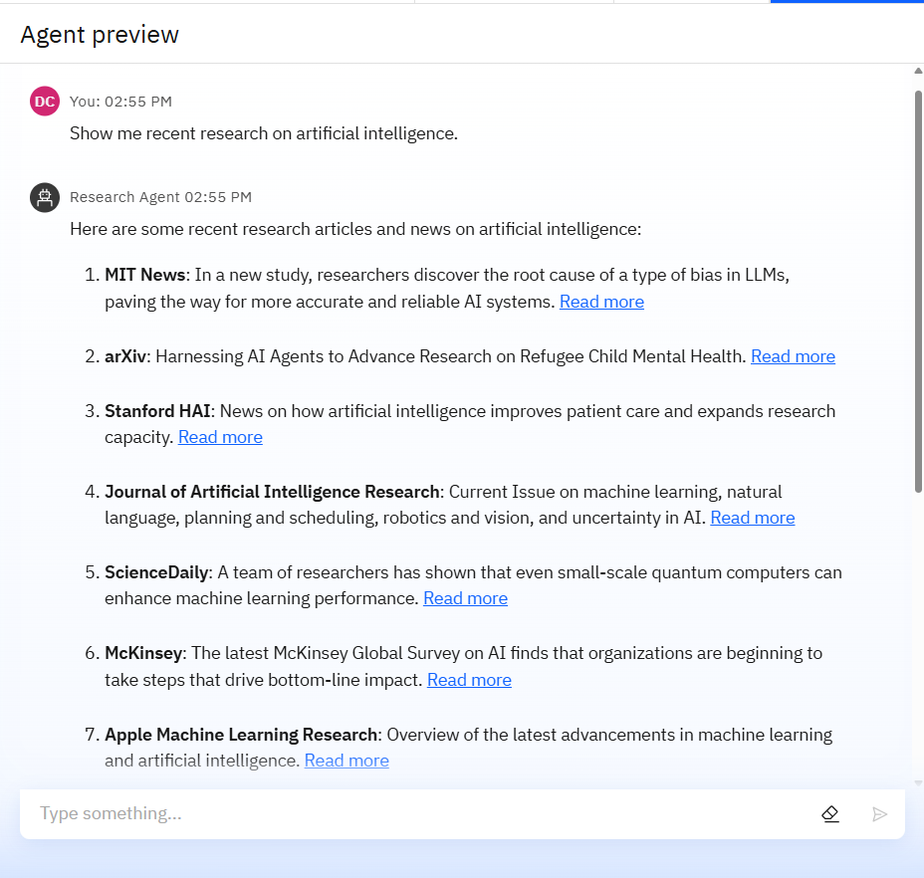
Results

Slide 10
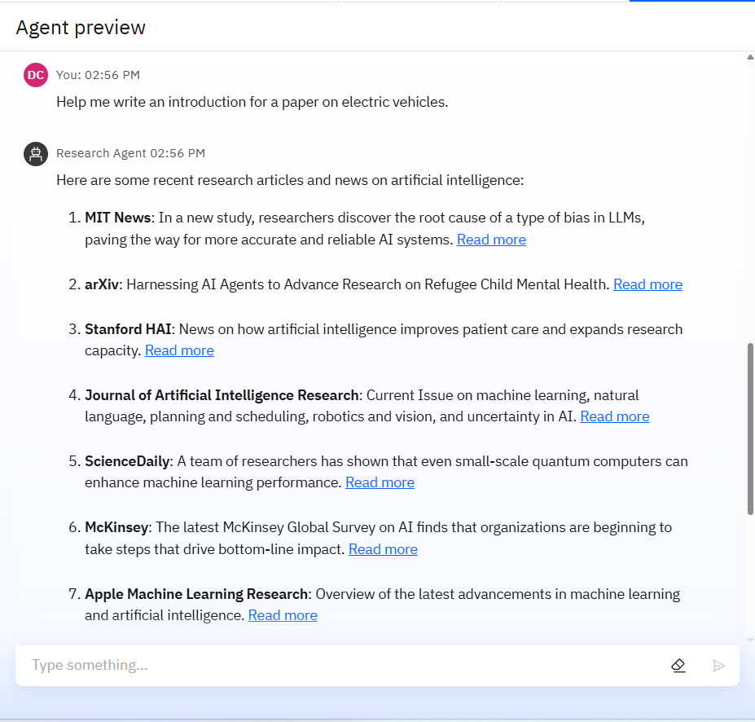
Results

Slide 11
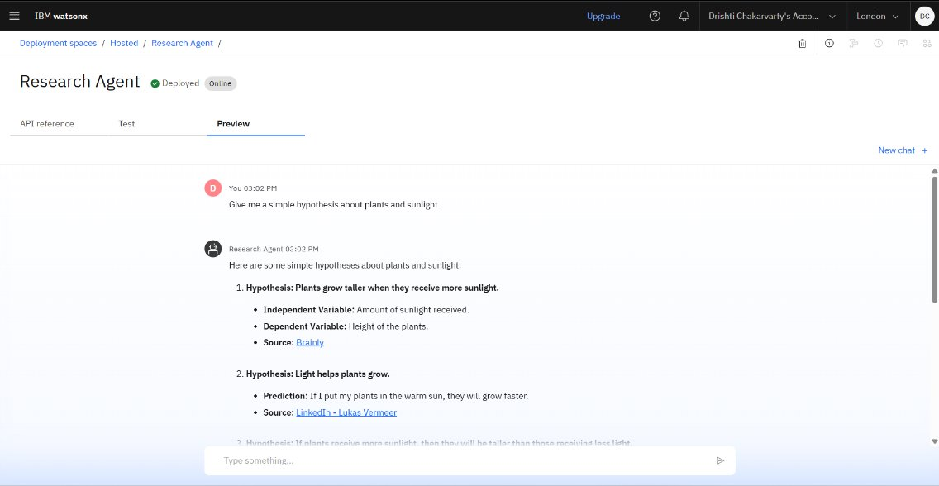
Results
Deployed AI Agent

Slide 12
Conclusion
The agent can generate reports, suggest hypotheses, and even draft sections of research papers.
It saves time by automating repetitive tasks like citation management and data extraction.
Research Agents enhance efficiency, accuracy, and innovation in both academic and industrial R&D.

Slide 13
GitHub Link
https://github.com/anwesh08kale/Research-AI_Agent/tree/main

Slide 14
Future scope
Multilingual Research Support
Voice-Activated Research Assistant
Real-Time Collaboration Features
Research Gap and Novel Topic Identification
Integration with Publishing Platforms
AI-Assisted Paper Drafting

Slide 15
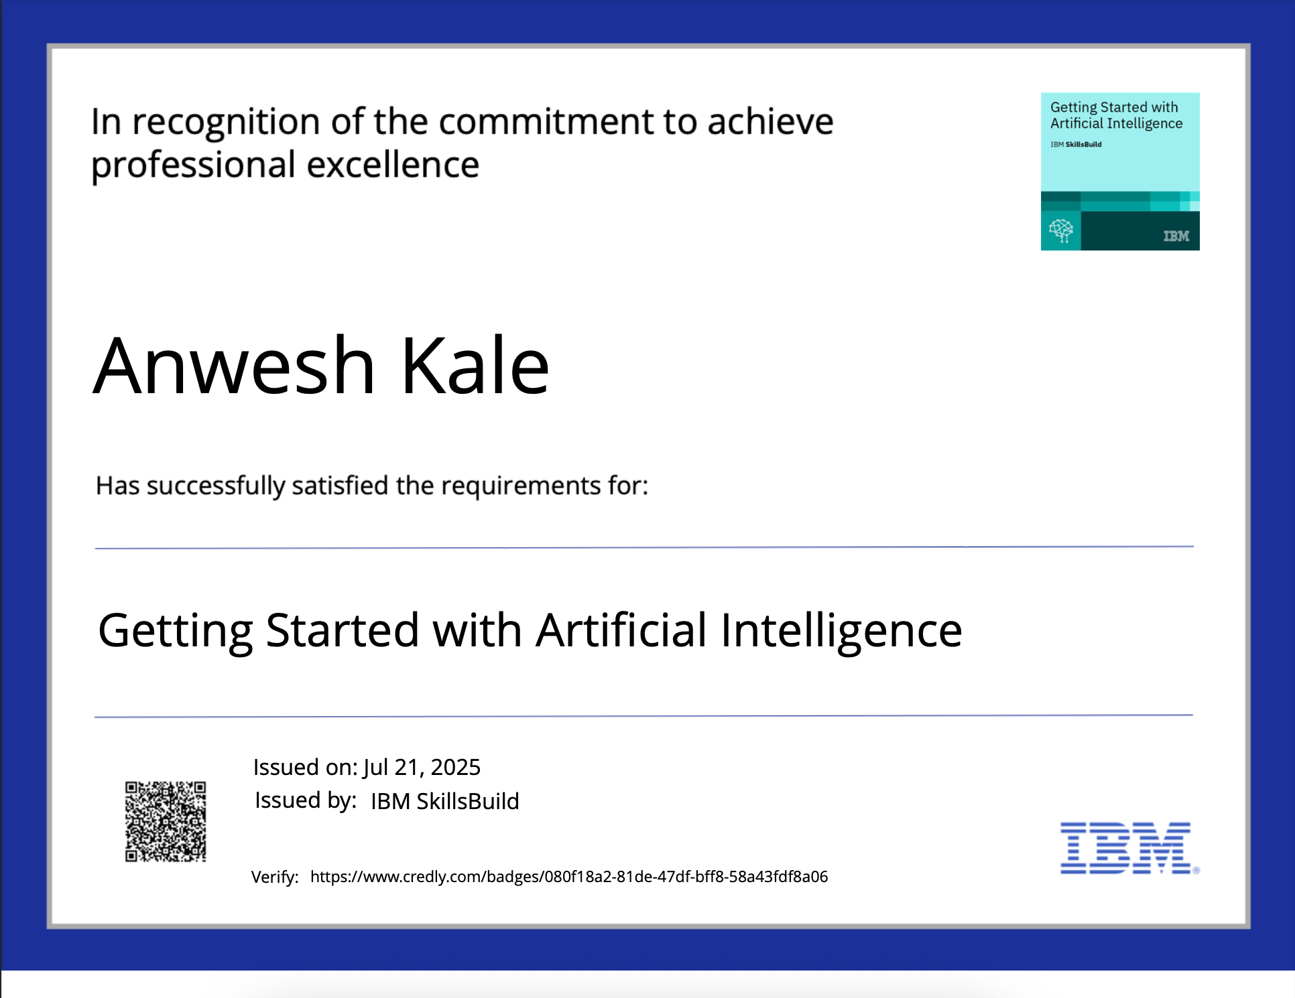
IBM Certifications

Slide 16
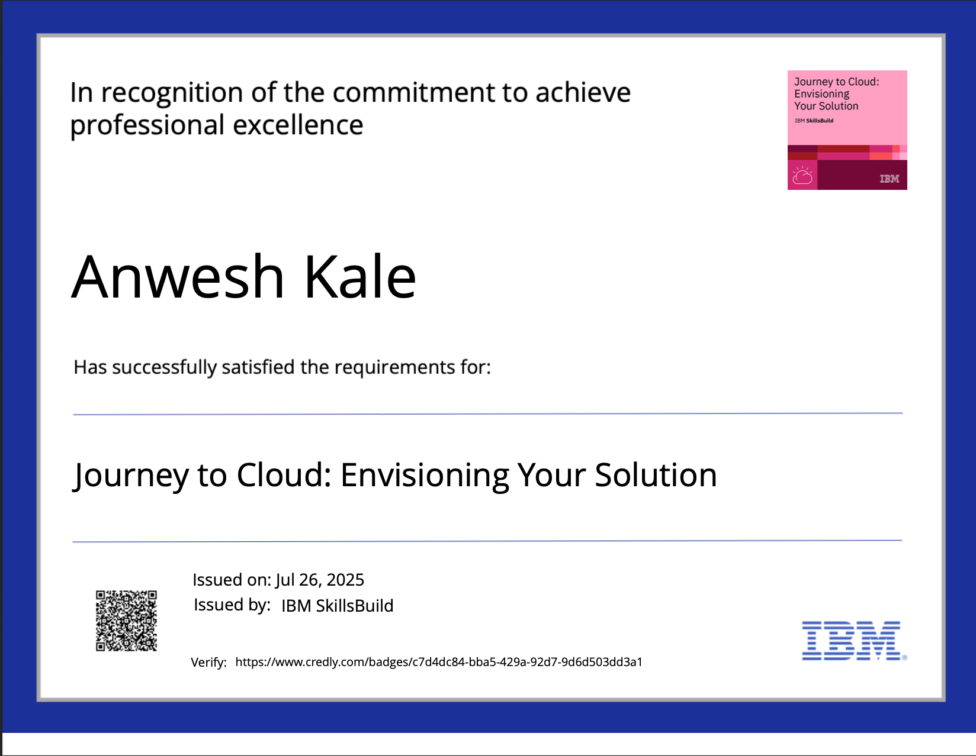
IBM Certifications

Slide 17
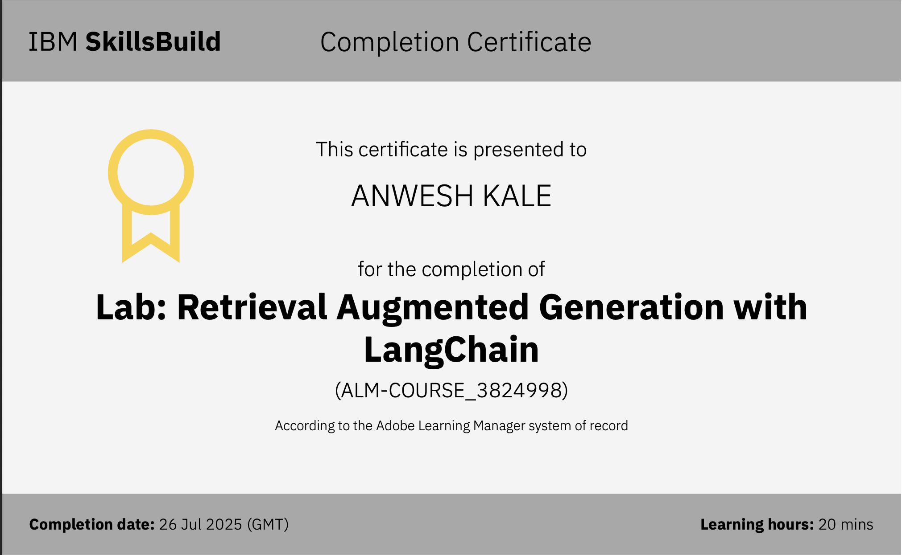
Attach your RAG LAB certificate here

Slide 18
THANK YOU

